Slide 1
Biological Fluid Stain Evidence: Blood and Semen
Key Word – Universal Precautions
Biological material must be considered hazardous!! Follow Universal Precautions when handling biological fluids/blood/semen – etc.

Slide 2
Biological Fluid Stain Evidence: Blood and Semen
Blood evidence has two primary categories:
  a. Bloodstain Pattern Interpretation
    Can be more significant than typing.
    May establish whether or not a crime occurred vs. suicide or accident.
    Can dispute or corroborate witnesses statements.

Slide 3
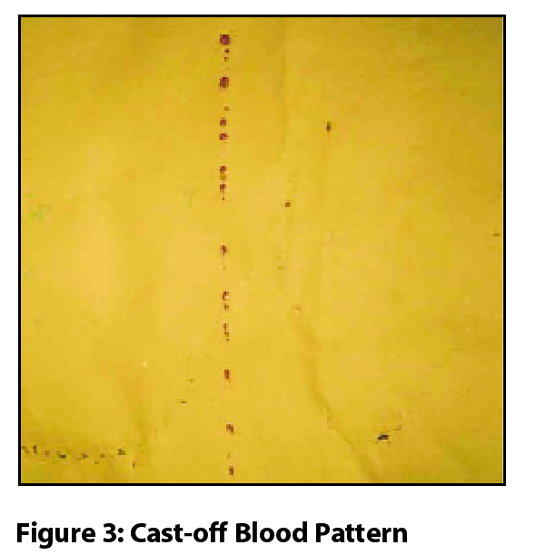
Biological Fluid Stain Evidence: Blood and Semen
Bloodstain Pattern Interpretations:

Slide 4
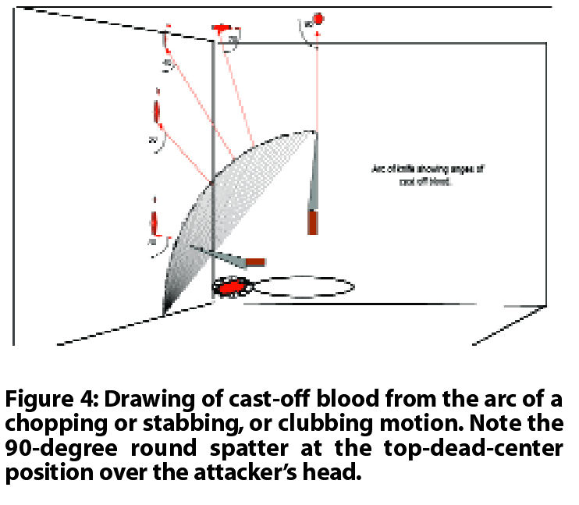
Biological Fluid Stain Evidence: Blood and Semen
Bloodstain Pattern Interpretations:

Slide 5
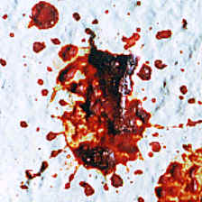
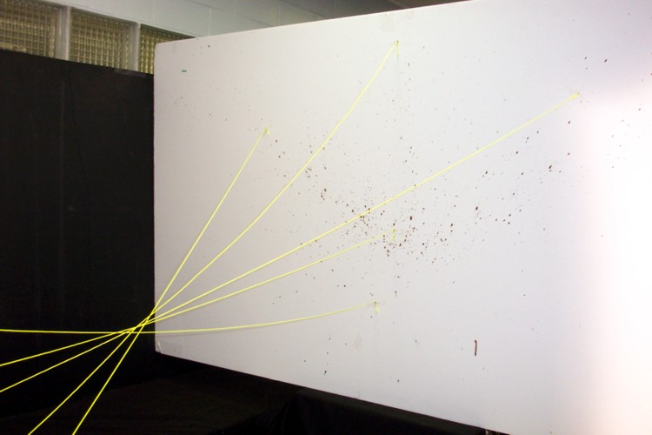
Biological Fluid Stain Evidence: Blood and Semen
Bloodstain Pattern Interpretations:

Slide 6
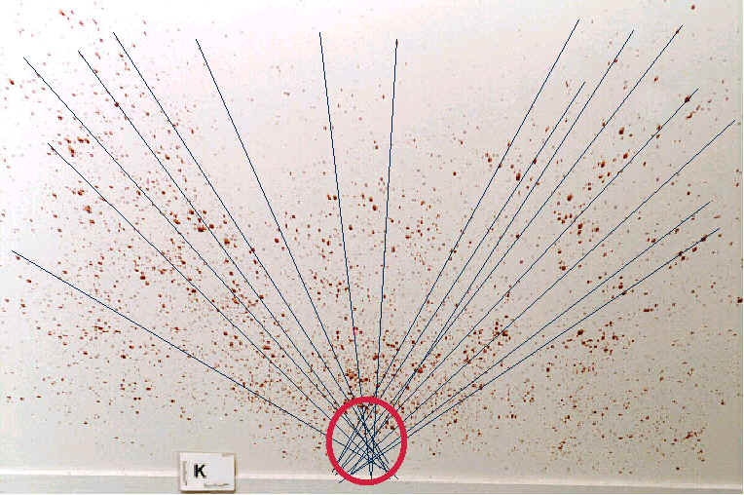
Biological Fluid Stain Evidence: Blood and Semen
Bloodstain Pattern Interpretations:

Slide 7
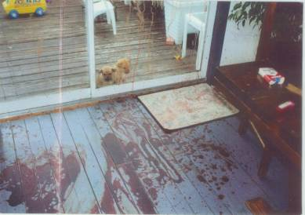
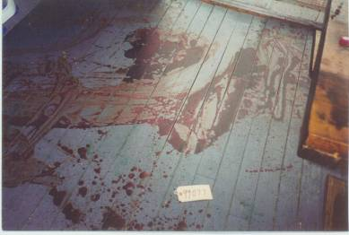
Biological Fluid Stain Evidence: Blood and Semen
Bloodstain Pattern Interpretaions:

Slide 8
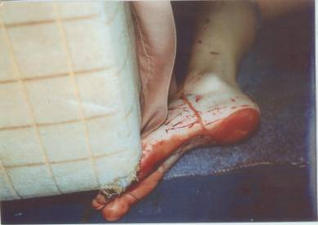
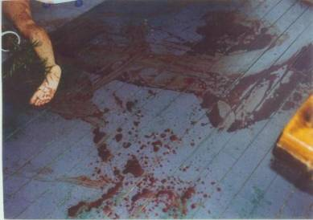
Biological Fluid Stain Evidence: Blood and Semen
Bloodstain Pattern Interpretations:

Slide 9
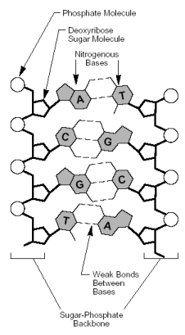
Biological Fluid Stain Evidence: Blood and Semen
b. Genetic Marker Typing.
  An integral part of the interpretation of the blood stain patterns – to establish from whom the bloodstain pattern emanated.

Slide 10
Nature of Genetic Markers
Genetic Marker:
  Genetic make-up of people.
  Inherited from biological parents.
  Produced in the body from DNA (deoxyribonucleic acid)
  (DNA) Genetic material that defines all the biological traits exhibited in an individual.

Slide 11
Nature of Genetic Markers
For Forensic Interests: ABO blood types are found in the “Red Blood Cells” (RBC)
Important for blood transfusion reactions and the protein hemoglobin (found in the fluid part of blood and other body fluids.

Slide 12
Nature of Genetic Markers
In 1960s the only genetic markers being typed in bloodstains were the familiar ABO blood type system the Rhesus (RH) system and the MN blood type system. (protein and enzymes)
1980s the DNA began to come alive.

Slide 13
ABO Blood Type
Consists of type A, type B, type O, and type AB.
Refers to the presence or absence of two blood groups (A and B).
Type A has an A factor on the blood cell
Type B has a B factor on the blood cell

Slide 14
ABO Blood Type
Type O has neither A or B on blood cell
Type AB has both A and B on blood cell
ABO blood types were the first genetic markers to be typed in bloodstains.
Not used near as much since DNA.

Slide 15
ABO Blood Type
Accompanied by a factor called “secretor”
75 – 80% of individuals are ABO secretors
Secrete their ABO blood type into bodily secretions such as sweat, tears, semen, and gastric fluids. (An inherited trait)

Slide 16
Enzyme & Protein Blood Types
Many enzymes & proteins are polymorphic (having several forms)
Typed using a process called “electrophoresis”

Slide 17
Enzyme & Protein Blood Types
Electrophoresis:
  Proteins and enzymes are separated and treated so their components can be visualized and the type can be determined.
  This gave the analyst the advantage of knowing who deposited the stain.
  (See fig. 9-1 on page 134)

Slide 18
Nature of DNA
Chromosomes carry genetic materials in cells – made up of DNA.
Genes are located on different sites (Loci) on the chromosomes.
Chromosomes exist in matching pairs – so do genes.

Slide 19
Nature of DNA
Two copies of a Gene are present at a given locus in any one individual
Genes may exist in different forms or alleles.
Many forms of a single cell exist in each person.

Slide 20
Nature of DNA
A particular pair of alleles at a locus defines a given individual’s genotype.
DNA carries all the genetic information for inheritance from generation to generation.
DNA referred to as a “double helix”

Slide 21
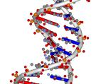


Nature of DNA
Structure of DNA molecule is made up of two strands hooked together and twisted into a helical configuration.

Slide 22
Nature of DNA
Each side of the Helix is composed of a large number of sugar molecules (ribose) that are formed into a chain by chemical bonding with phosphoric acid.
Ribose is missing an oxygen molecule, lost when forming the chain, thus the term “deoxy,” (missing an oxygen molecule)

Slide 23
Nature of DNA
Both sides of the Helix is held together by four “bases”.
Adenine [A]
Guanine [G]
Thymine [T]
Cytosine [C]

Slide 24
Nature of DNA
The bases exist in pairs.
Thymine is always paired with Adenine
Cytosine is always paired with Guanine
Complimentary Base Pairing: Each individual base has the ability to “recognize” and bind to its complimentary base.

Slide 25
Nature of DNA
The average human Chromosome contains 120 million base pairs.
The total human genome contains approximately 3 Billion base pairs.
Typical Gene (small) contains perhaps 20 to 100 Kilobase pairs.

Slide 26
Nature of DNA
Two types of DNA in each cell (except Spermatozoa):
Nuclear DNA (nDNA) Contains a nucleus in the cell. (
Mitochondrial DNA (mtDNA) Do not contain a nucleus in the cell. (hair, fingernail, epidermis, toenail)

Slide 27
Nature of DNA
Nuclear DNA is a fusion of the DNA from the sperm and the DNA from the egg at conception.
Furnishes the blueprint for production of all the substances that make up the human body.

Slide 28
Nature of DNA
Genes (in the nDNA) include all traits that distinguish one individual from another – hence the term “genetic markers.”
mtDNA – Found in small organelles (small organs) in the cell.

Slide 29
Nature of DNA
Mitochondria – located in the cell but outside the cell nucleus.

